Slide 1
Dimensionality Reduction: Principal Component Analysis
Prepared by:
Rutvy Dhanesh Makwana
Tirth Manojkumar Patel
Pruthvik Dash
Instructor: Dr. Yasser Alginahi
Date of Submission: November 10, 2023
1

Slide 2
Table of Contents
Dimensionality Reduction
Why Dimensionality Reduction is needed?
PCA theory
PCA with real life example
Coded Example of PCA in action
Applications of PCA
Advantages and Disadvantages of PCA
Conclusion
References
2

Slide 3
Dimensionality Reduction
Dimensionality Reduction refers to a technique for reducing the number of input variables in the training data.
Useful when dealing with high dimensional data by projecting the data to a lower dimensional subspace.
3

Slide 4
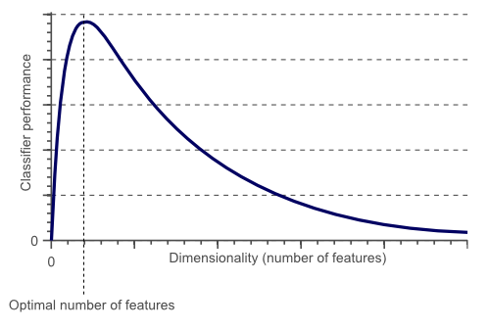
Dimensionality Reduction
Working with more dimensions of data initially boosts predictive ability but gets progressively challenging as the number of dimensions grows.
source: https://tinyurl.com/4nsdy98r
4

Slide 5
Why Dimensionality Reduction is needed?
1. Simplifies Models
2. Computational Complexity
3. Curse of Dimensionality
4. Enhances Visualization
5. Removes Redundant Information
5

Slide 6
Principle Component Analysis
PCA is a linear dimensionality reduction approach that turns a set of correlated high-dimensional features into a set of uncorrelated low-dimensional features.
These uncorrelated features are called PRINCIPAL COMPONENTS.
6

Slide 7
Working of Principal Component Analysis
Principal Component Analysis is a projection based method that transforms the data by projecting it onto a set of orthogonal(perpendicular) axes.
It essentially finds the best linear combinations of the original variables such that the variance is maximum.
7

Slide 8
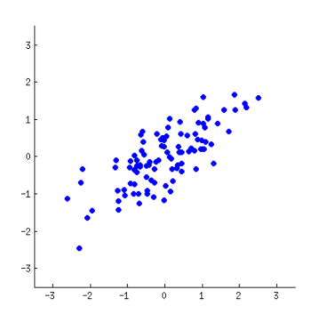
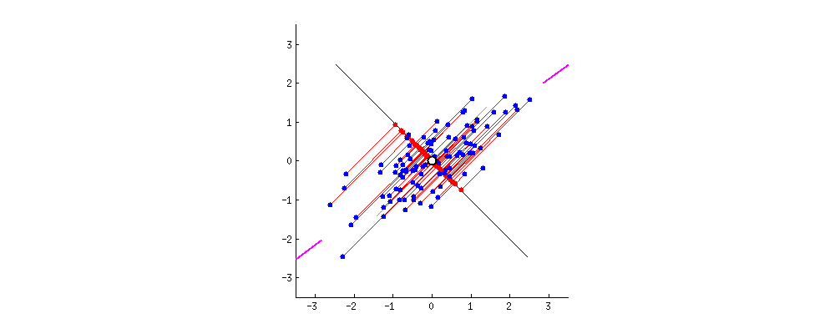
Example: Reducing 2 dimensional to 1 dimensional
source: https://tinyurl.com/5eh46chz
8

Slide 9
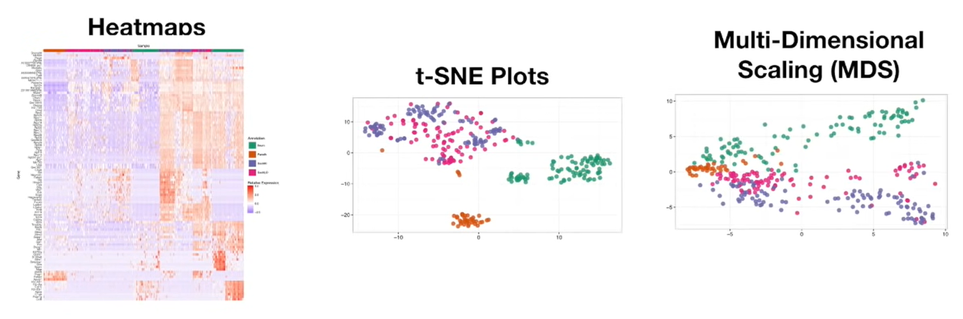
Dimensionality Reduction
Different methods in Dimensionality Reduction:
source: https://tinyurl.com/24v5etfr
9

Slide 10
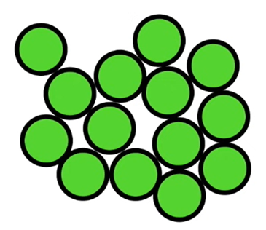
PCA with real life example
Lets say we had some normal cells…
Unfortunately, we can’t observe the differences from the outside…
…so we sequence the mRNA in each cell to identify which genes are active. This tells us what the cell is doing.
source: https://tinyurl.com/24v5etfr
10

Slide 11
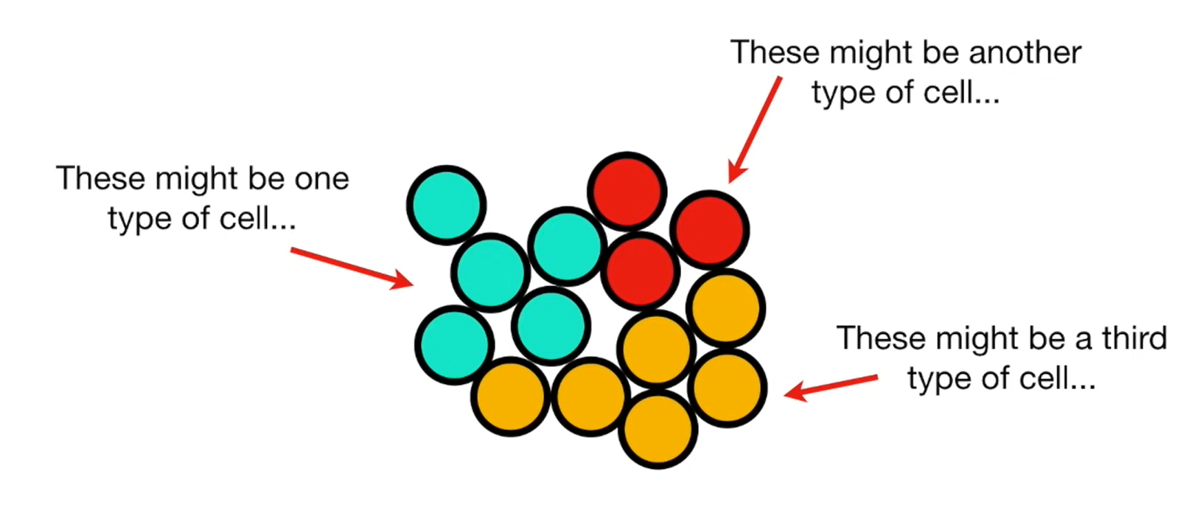
PCA with real life example
source: https://tinyurl.com/24v5etfr
11

Slide 12
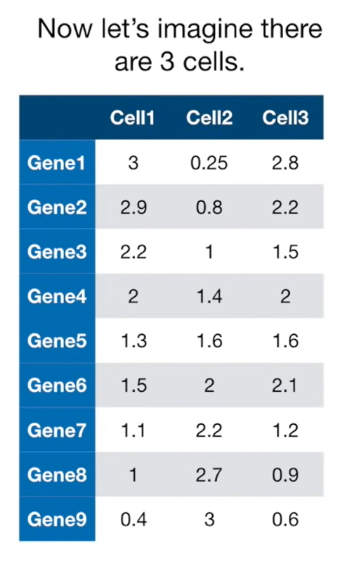
PCA with real life example
Here’s the data…
Each column shows how much
each gene is transcribed in
each cell.
source: https://tinyurl.com/24v5etfr
12

Slide 13
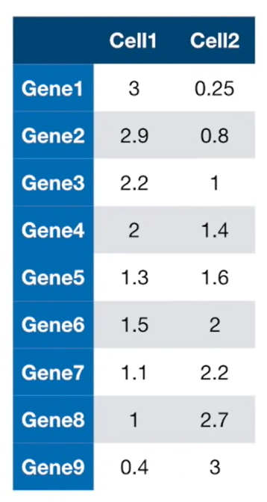
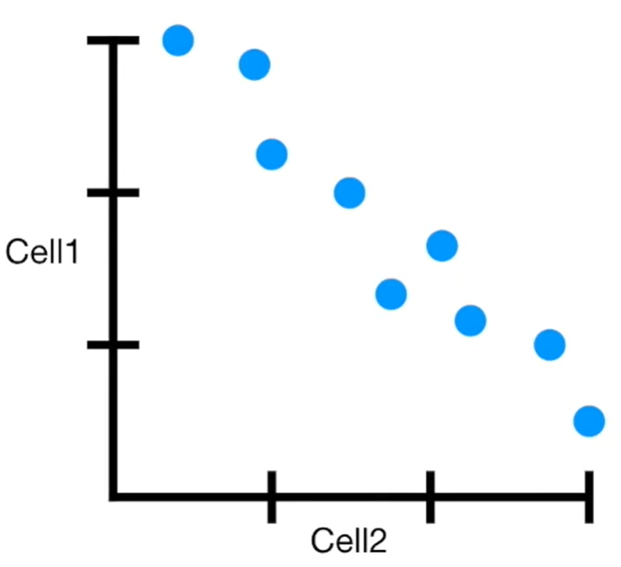
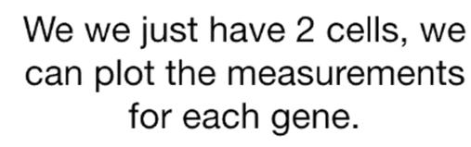
PCA with real life example
source: https://tinyurl.com/24v5etfr
13

Slide 14
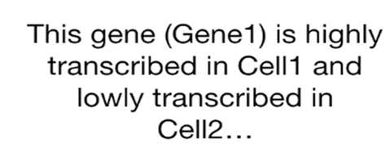

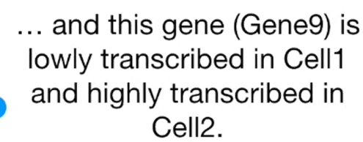
PCA with real life example
source: https://tinyurl.com/24v5etfr
14

Slide 15
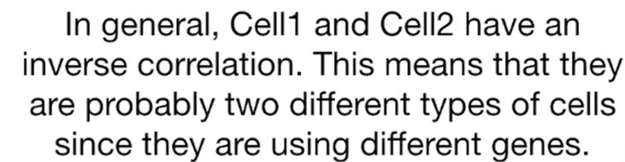
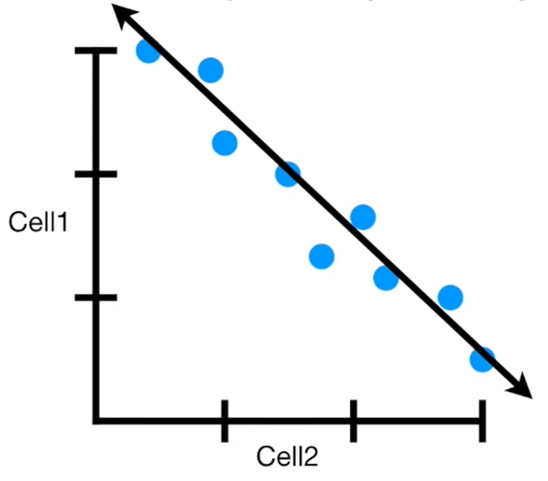
PCA with real life example
source: https://tinyurl.com/24v5etfr
15

Slide 16
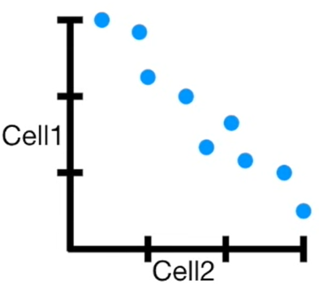
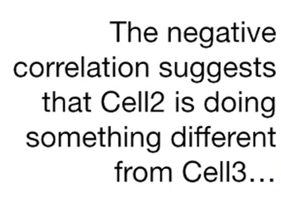
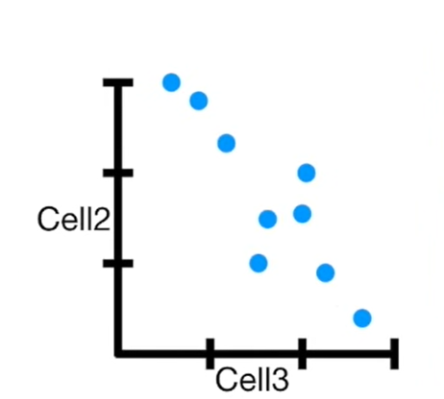
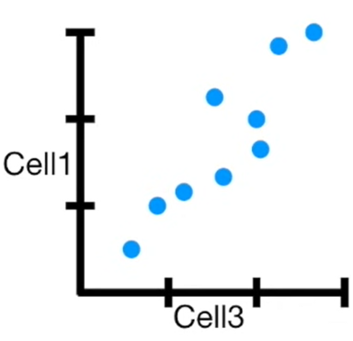
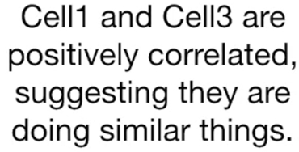
PCA with real life example
source: https://tinyurl.com/24v5etfr
16

Slide 17
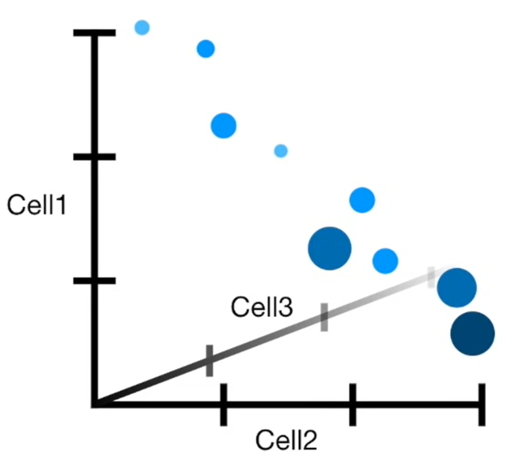
PCA with real life example
Alternatively, we could try to plot all three cells at once on a 3-dimensional graph.
source: https://tinyurl.com/24v5etfr
17

Slide 18
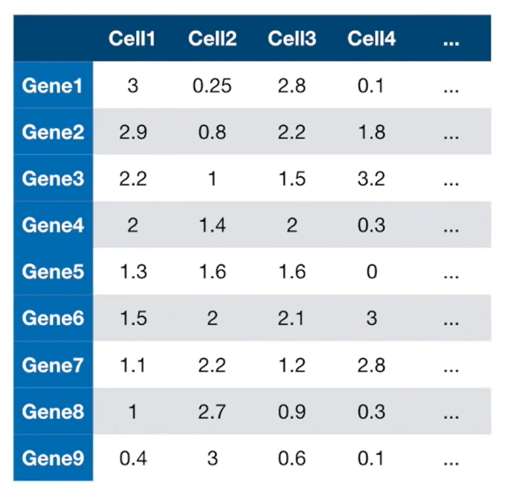
PCA with real life example
But what do we do when we have 4 or more cells?
source: https://tinyurl.com/24v5etfr
18

Slide 19
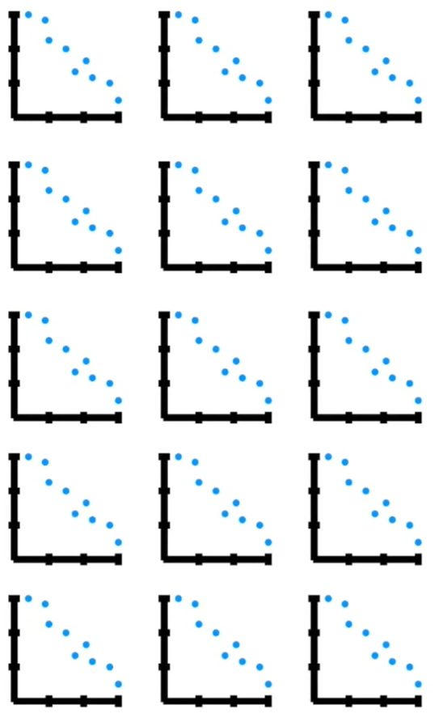
PCA with real life example
Draw tons and tons of 2 cell plots and try to make sense of them all?
source: https://tinyurl.com/24v5etfr
19

Slide 20
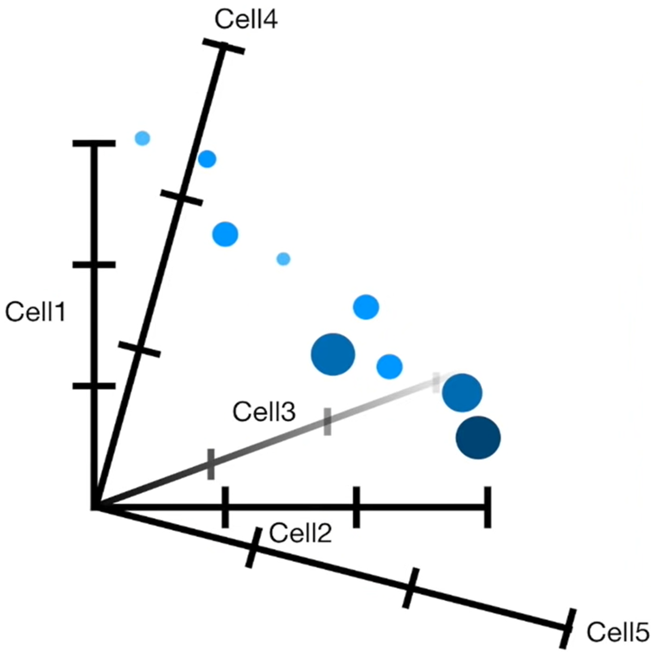
PCA with real life example
Or
draw some crazy graph that has an axis for each cell and makes our brain explode?
source: https://tinyurl.com/24v5etfr
20

Slide 21
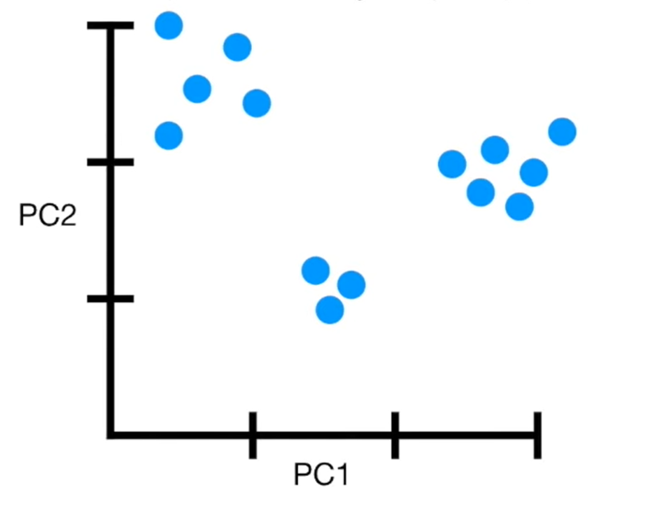
PCA with real life example
No, both of those options will not work.
Instead, we draw a Principal Component Analysis(PCA) plot…
A PCA plot converts the correlations (or lack thereof) among all the cells into a 2-D graph.
source: https://tinyurl.com/24v5etfr
21

Slide 22
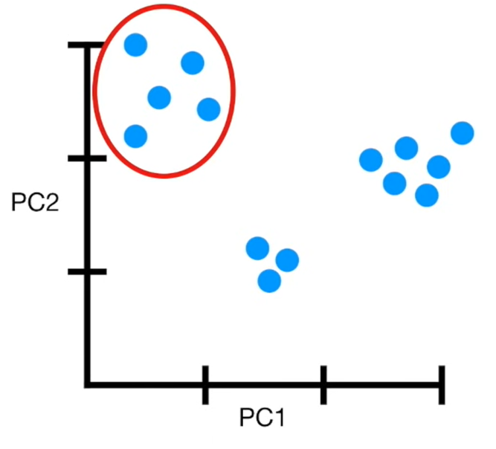
PCA with real life example
This cluster of cells are highly correlated with each other…
Cells that are highly correlated cluster together…
source: https://tinyurl.com/24v5etfr
22

Slide 23
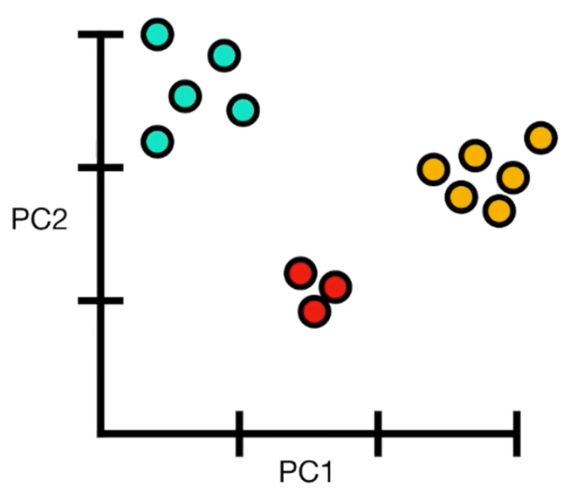
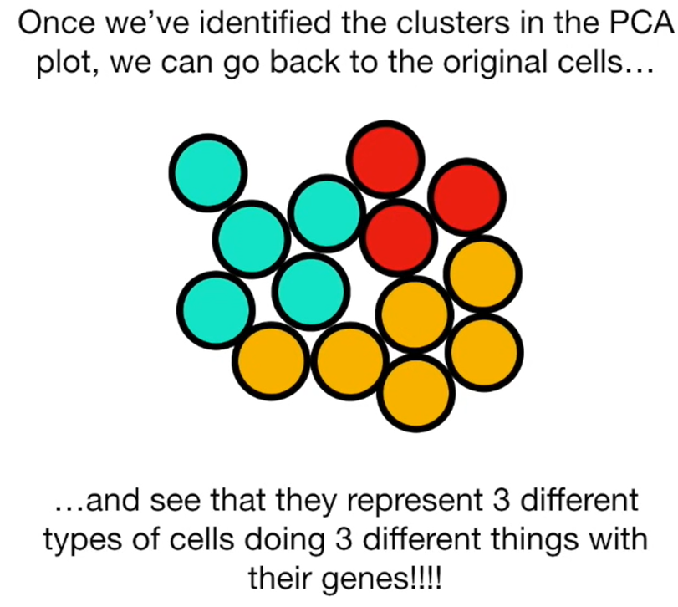
PCA with real life example
Once we’ve identified the clusters in the PCA plot,we can go back to the original cells….
…and see that they represent 3 different types of cells doing 3 different things with their genes!!!!
source: https://tinyurl.com/24v5etfr
23

Slide 24
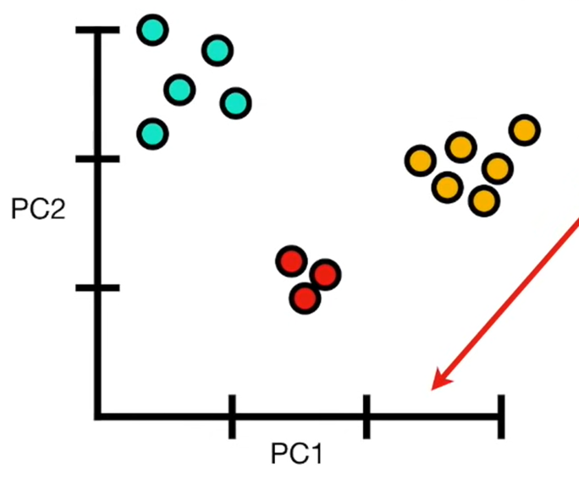
PCA with real life example
Here’s one last main idea about how to interpret PCA plots:
The axes are ranked in order of importance.
Differences along the first principal component axis(PC1)…
source: https://tinyurl.com/24v5etfr
24

Slide 25
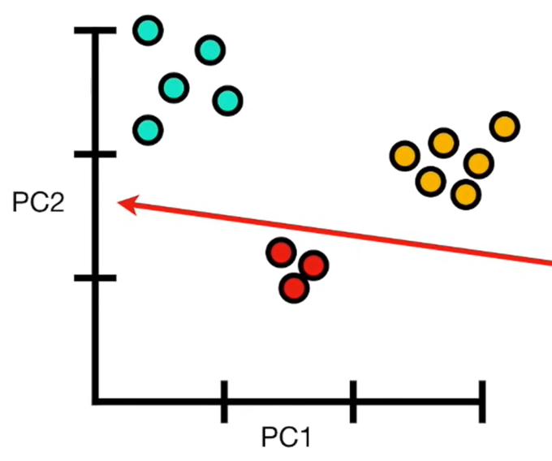
PCA with real life example
Differences along the first principal component axis(PC1)…
…are more important than differences along the second principal component axis(PC2).
source: https://tinyurl.com/24v5etfr
25

Slide 26
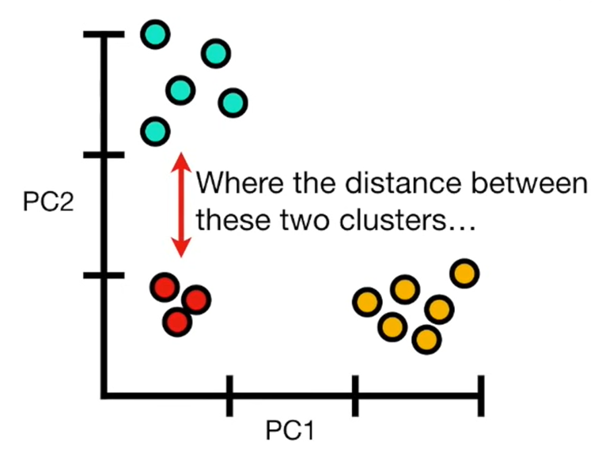
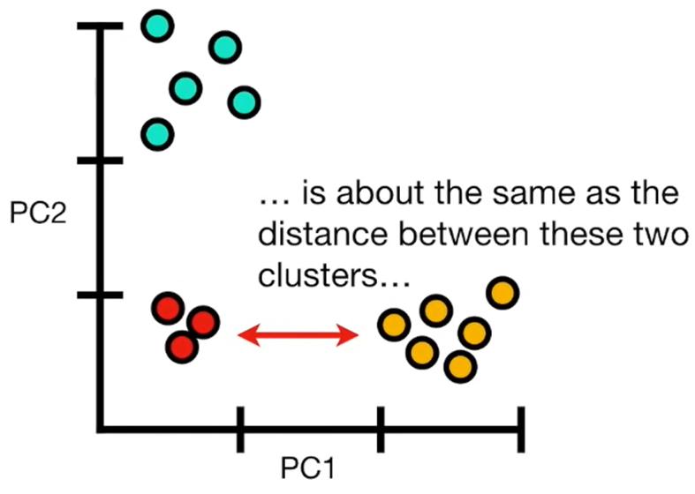
PCA with real life example
source: https://tinyurl.com/24v5etfr
26

Slide 27
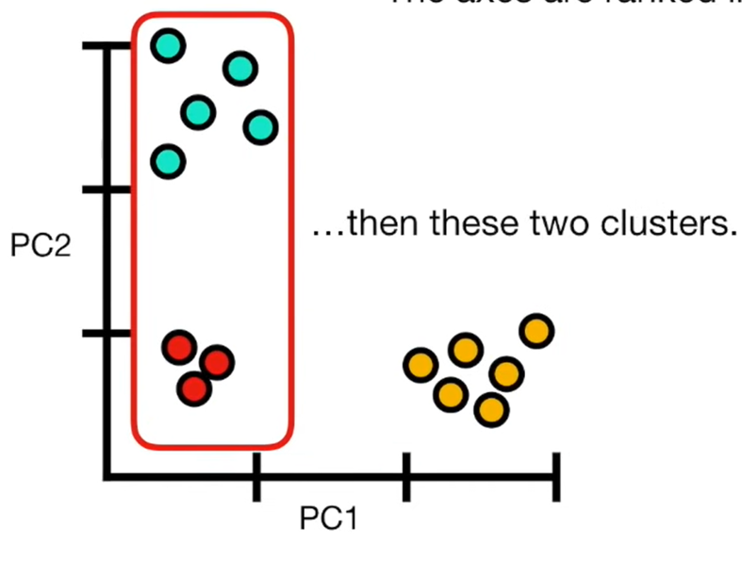
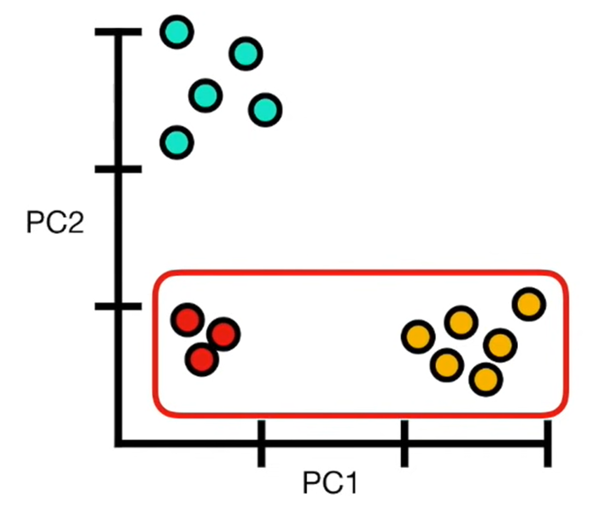
PCA with real life example
…then these two clusters are more different from each other…
source: https://tinyurl.com/24v5etfr
27

Slide 28
Steps in PCA
Standardize the Data:
Ensure all features have the same scale.
Calculate Covariance Matrix:
Describes how different features vary together.
Compute Eigenvectors and Eigenvalues:
Eigenvectors: Directions of maximum variance.
Eigenvalues: Magnitudes of the variance in each direction.
Choose Principal Components:
Select the top eigenvectors based on eigenvalues.
Project Data Onto Principal Components:
Transform the data into the new reduced-dimensional space.
28

Slide 29
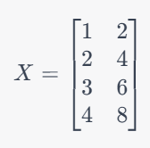
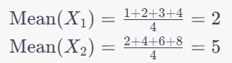
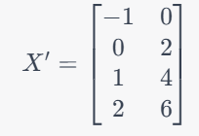
Example For PCA
Suppose we have 2D dataset.
Calculate the Mean:
Center the data:
29

Slide 30
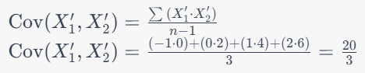
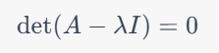
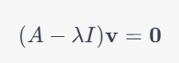
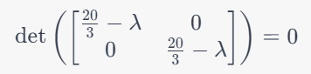
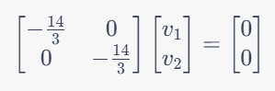
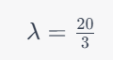
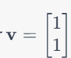
Example For PCA
3. Calculate Covariance Matrix:
4. Calculate Eigenvectors and Eigenvalues:
Solving for eigenvectors and eigenvalues, an eigenvector [1,1] and eigenvalue 10.
30

Slide 31
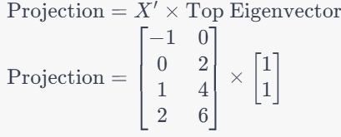
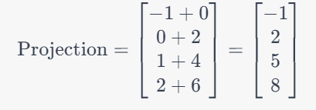
Example For PCA
5. Project Data Onto Principal Component:
So, in this simplified example, we retained only one dimension, and the projected data is [−1,2,5,8].
31

Slide 32
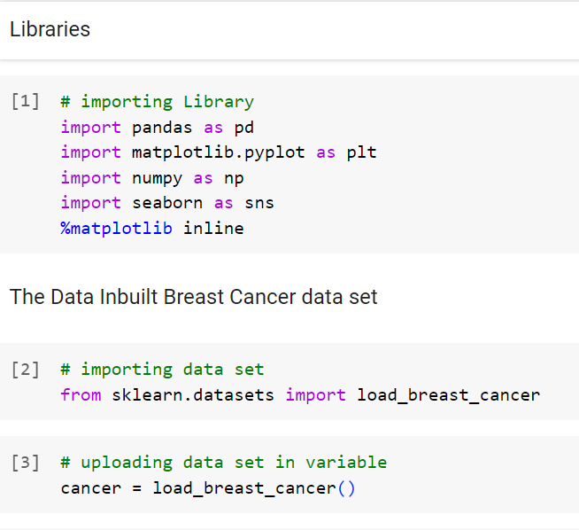


Coded Example of PCA
Code Link Access:
https://colab.research.google.com/drive/18O8QXvwjDIgePfGSfLN2MKoP5lrIphhu#scrollTo=pADSbZ77u34J
dict_keys(['data', 'target', 'frame', 'target_names', 'DESCR', 'feature_names', 'filename', 'data_module'])
source: https://tinyurl.com/4phpne3x
32

Slide 33
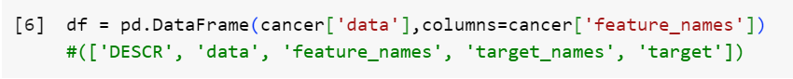

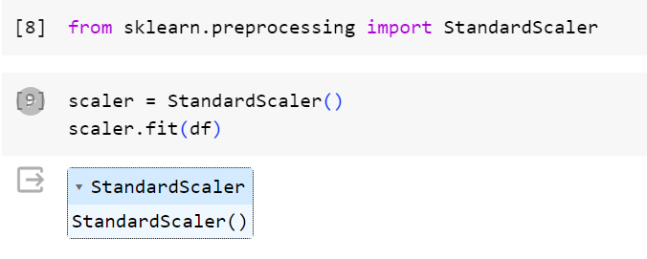
Coded Example of PCA
source: https://tinyurl.com/4phpne3x
33

Slide 34
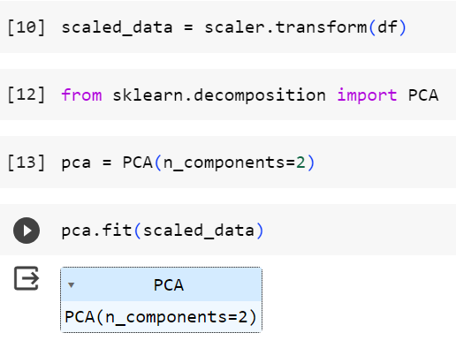
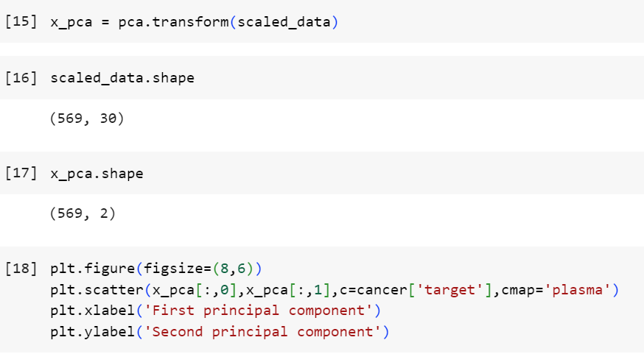
Coded Example of PCA
source: https://tinyurl.com/4phpne3x
34

Slide 35
Applications
1. Image Compression
2. Face Recognition
3. Speech Recognition
35

Slide 36
Advantages of Principal Component Analysis
1. Noise Reduction
2. Visualization
3. Collinearity Handling
36

Slide 37
Disadvantages of Principal Component Analysis
Information Loss
Dimensionality reduction involves some loss of information.
The challenge is to strike a balance between reducing dimensionality and retaining enough information for the specific task at hand.
Non-linearity
PCA assumes linear relationships between features. Non-linear dimensionality reduction techniques (e.g., t-Distributed Stochastic Neighbor Embedding - t-SNE) exist for capturing more complex relationships.
37

Slide 38
Conclusion
Key Takeaways
PCA is Powerful:
PCA is a powerful technique for dimensionality reduction.
Simplification and Retention:
It simplifies data while retaining essential information.
Careful Component Selection:
Carefully choose the number of components based on explained variance.
38

Slide 39
Refrences
[1] J. Brownlee, “Introduction to dimensionality reduction for machine learning,” MachineLearningMastery.com, https://machinelearningmastery.com/dimensionality-reduction-for-machine-learning/#:~:text=Dimensionality%20reduction%20refers%20to%20techniques%20for%20reducing%20the%20number%20of,%E2%80%9Cessence%E2%80%9D%20of%20the%20data. (accessed Nov. 10, 2023).
[2] K. Parte, “Dimensionality reduction: Principal Component Analysis,” Medium, https://medium.com/analytics-vidhya/dimensionality-reduction-principal-component-analysis-d1402b58feb1 (accessed Nov. 10, 2023).
[3] N. S. Chauhan, “Dimensionality reduction with principal component analysis (PCA),” KDnuggets, https://www.kdnuggets.com/2020/05/dimensionality-reduction-principal-component-analysis.html (accessed Nov. 10, 2023).
[4] A. K. Pal, “Tutorial: Understanding dimension reduction with principal component analysis,” Paperspace Blog, https://blog.paperspace.com/dimension-reduction-with-principal-component-analysis/ (accessed Nov. 10, 2023).
[5] “Dimensional Reduction| Principal Component Analysis,” www.youtube.com. https://www.youtube.com/watch?v=OFyyWcw2cyM&ab_channel=KrishNaik (accessed Nov. 10, 2023).
39

